Slide 1
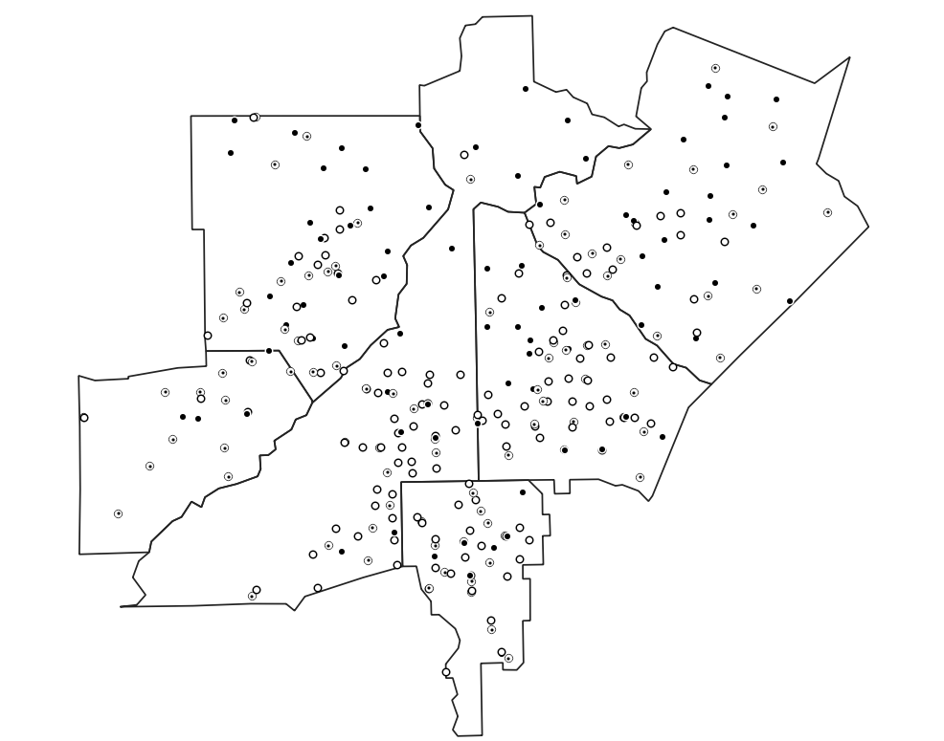
Week 4: Spatial data; Point pattern analysis
Geog4300: Shannon

Slide 2
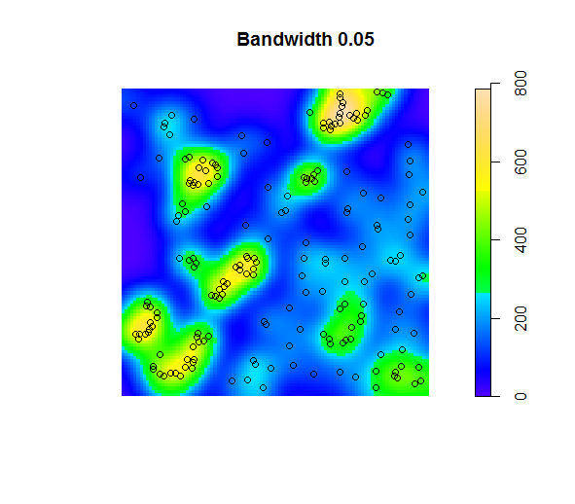
This week: Describing spatial data
Point pattern analysis
Mean center
Nearest neighbor index
Kernel density
Location quotient
Quadrats
MAUP

Slide 3
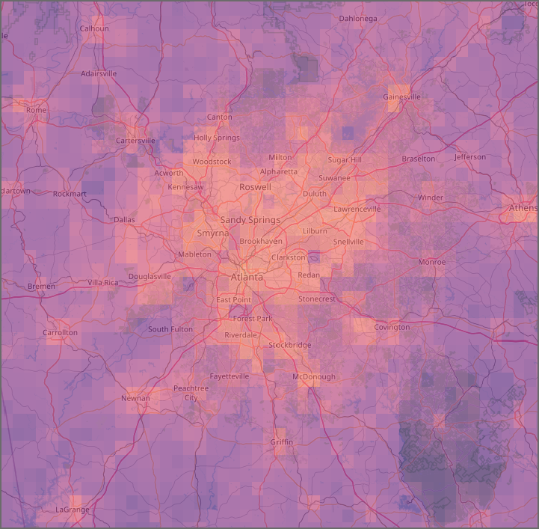
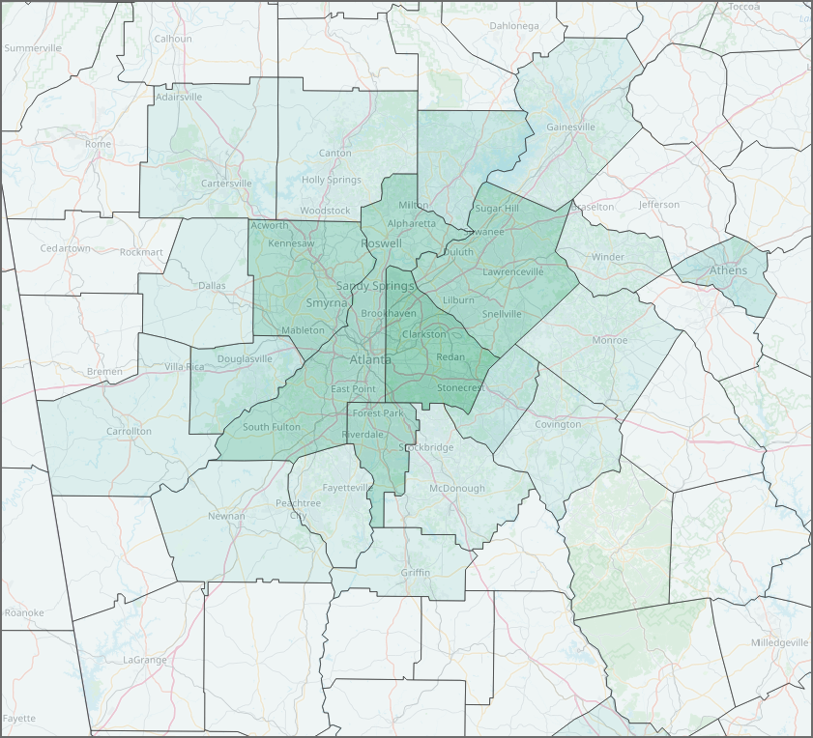
Spatial data 101: Vector and raster data
Two maps of population density

Slide 4
Spatial data 101: File types
Vector: Shapefile, GeoJSON, KML, Geopackage, CSV, XLX,…
Raster: GeoTIFF, NetCDF, etc.

Slide 5
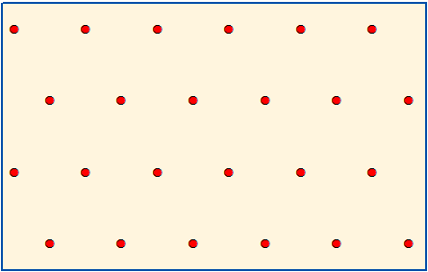
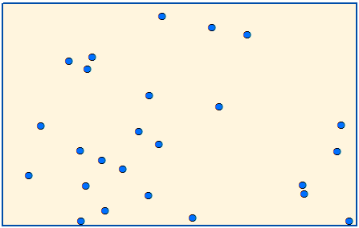
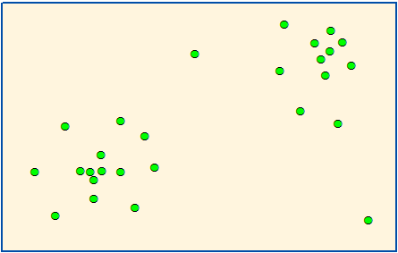
Point pattern analysis
How do we identify patterns in the distribution of point data?
Clustering and dispersion of point data
Distribution of point incidents (disease, natural disasters, species, crime, etc.)
Relative frequency of subevents (strong tornadoes, particular disease variants, etc.)

Slide 6

Nearest Neighbor Index
$$\frac{Actual average distance}{Distance for random distribution}$$

Slide 7
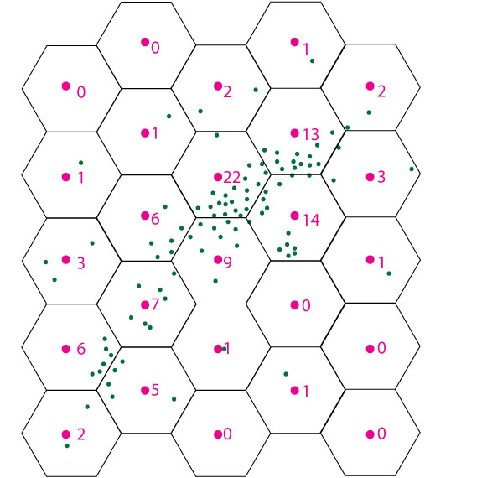
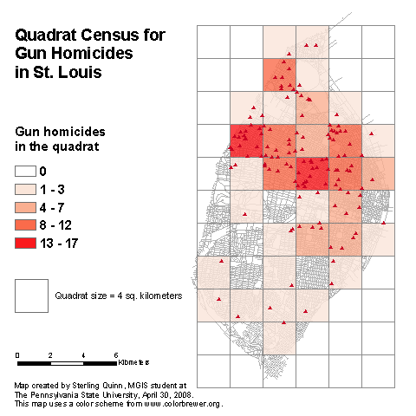
Quadrats
Aggregating points to a tessalated grid, usually squares or hexagons

Slide 8
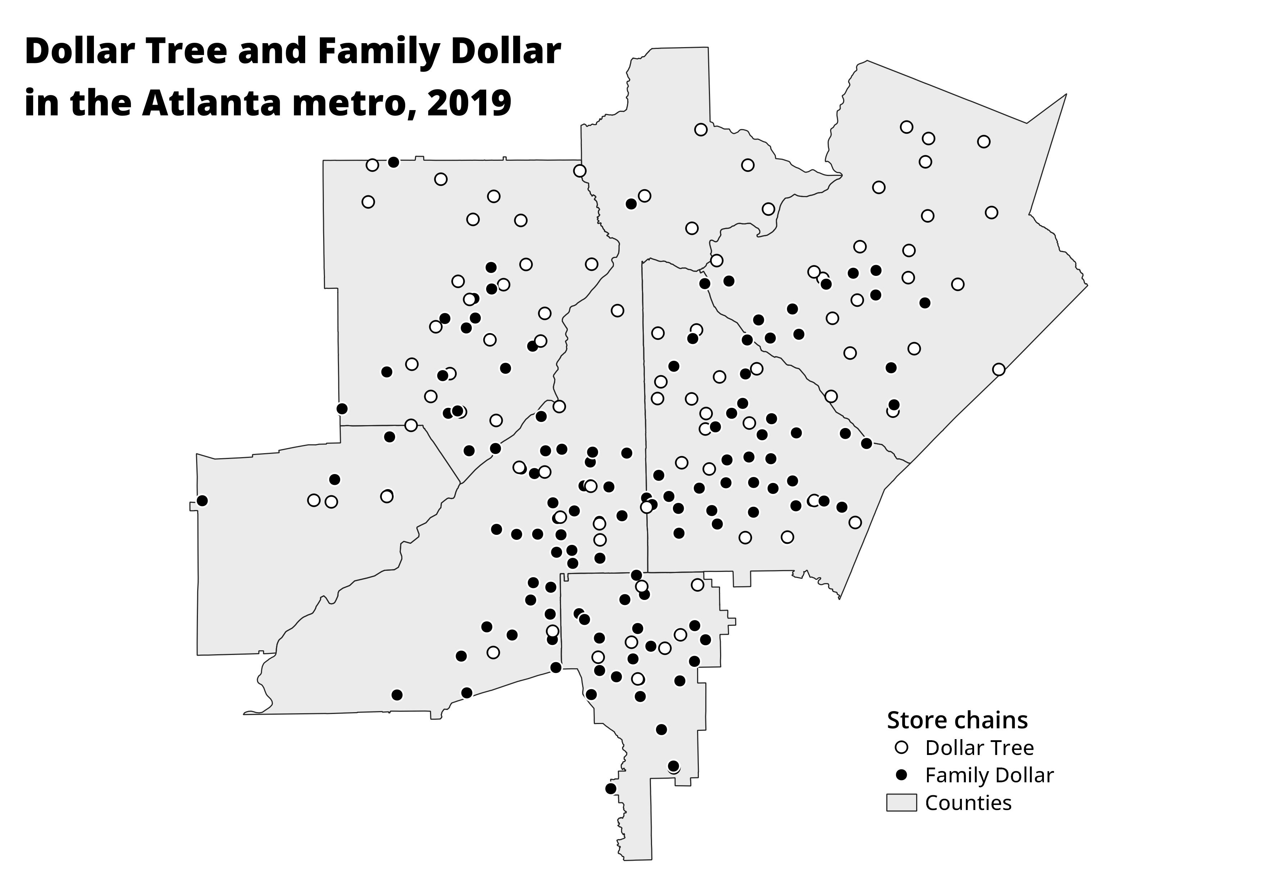
Let’s try it!
Dollar stores in Atlanta
Create a quadrat grid of 1.5 or 3 inch squares
Count the total stores for each chain in each grid cell

Slide 9

Location quotient
Relative incidence of a particular event
Pick a chain and count just those points
What is the percentage of all stores for each grid cell?
$$LQ=\frac{{pct}_{subarea}}{{pct}_{area}}$$
For the whole area:
Dollar General: 31% (93/305)
Dollar Tree: 28% (86/305)
Family Dollar: 41% (126/305)

Slide 10
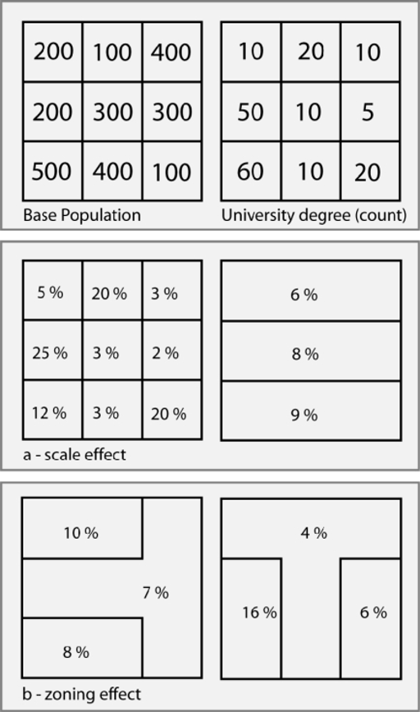
The Modifiable Areal Unit Problem
How did our quadrat maps vary?

Slide 11
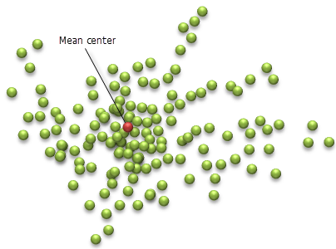
Mean center
What is the average X/Y coordinate of each point?
Open the dollarstores_atlcore CSV file in Excel/Sheets (file is in the repo)
What’s the mean X and Y coordinate for each store chain?
Where are each of those points located?
What does this mean?

Slide 12
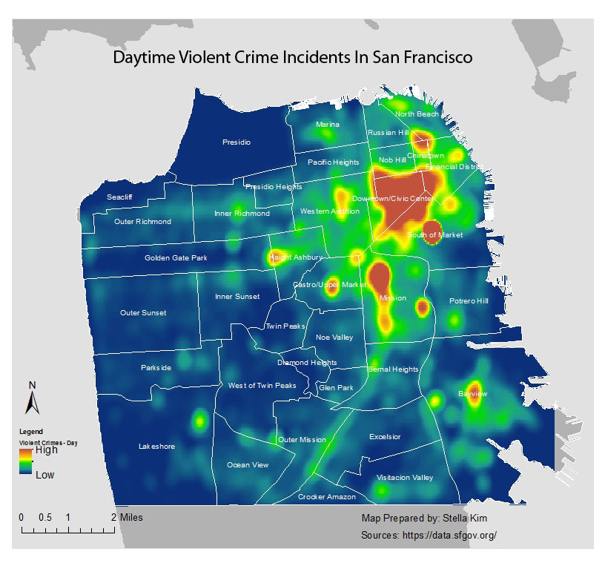
Kernel density estimation

Slide 13
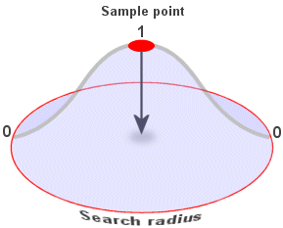
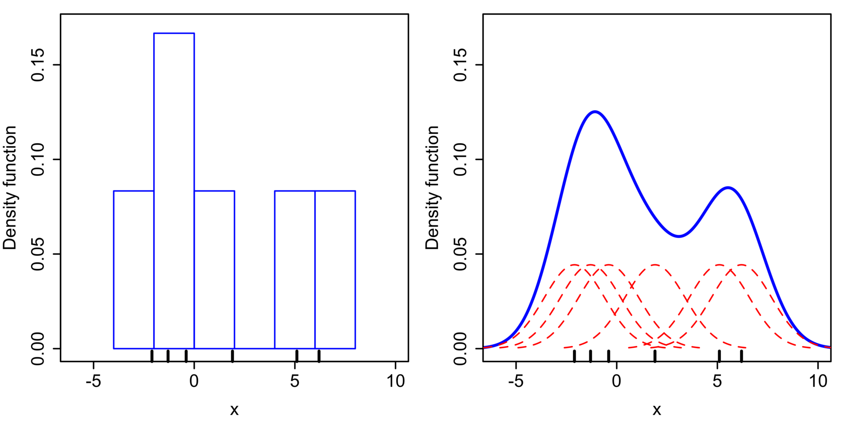
Kernel density estimation

Slide 14

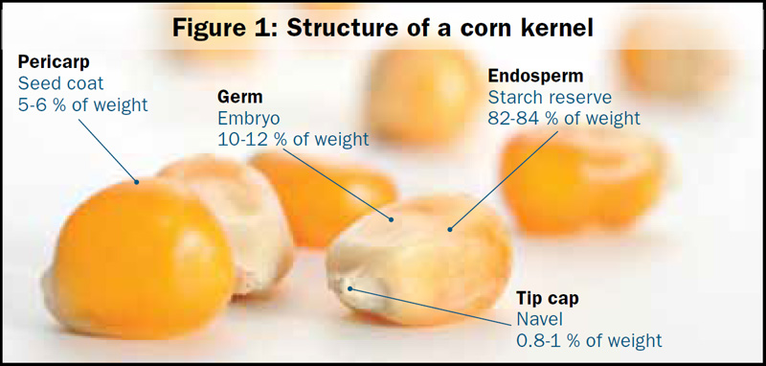
Problems with kernel density estimation
Fuzzy estimates rather than precise points
Influential outliers

Slide 15
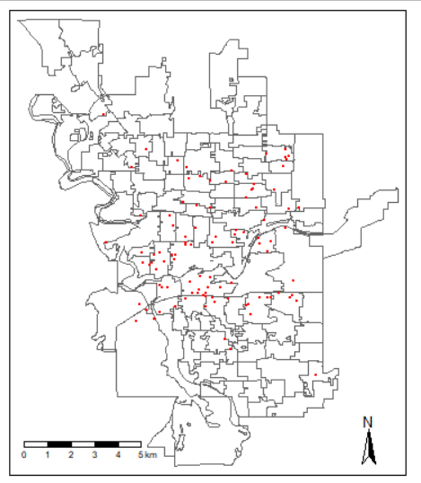
Lab 2
Mapping reported crime in Spokane, WA
Mean centers by type of offense
Calculating crime rates by precinct
Calculating the LQ for burglaries
Bonus: Creating a quadrat map

